Slide 1

Binary Search E-Commerce Project
This presentation explores our e-commerce website and how we implemented binary search to improve search efficiency. Learn about the technologies we used and the challenges we overcame during development.
Made by :-
Pardeep Kumar(2330165)
Pawan Sharma(2330166)
Mukul Anand(2330155)
Piyush Raj(2330169)

Slide 2
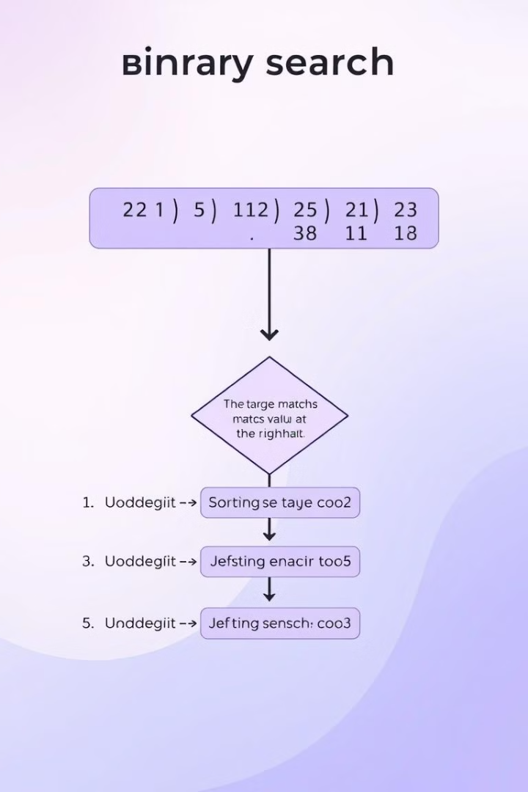
Introduction: What is Binary Search?
Binary search is an efficient algorithm for finding a target value within a sorted dataset. It works by repeatedly dividing the search interval in half. Its time complexity is O(log n), making it faster than linear search for large datasets.

Slide 4

Project Overview: E-Commerce Website
Our project is a fully functional e-commerce website. Built using HTML, CSS, and JavaScript, its core feature is product search. We implemented binary search in JavaScript to enable quick and precise product retrieval.

Slide 5
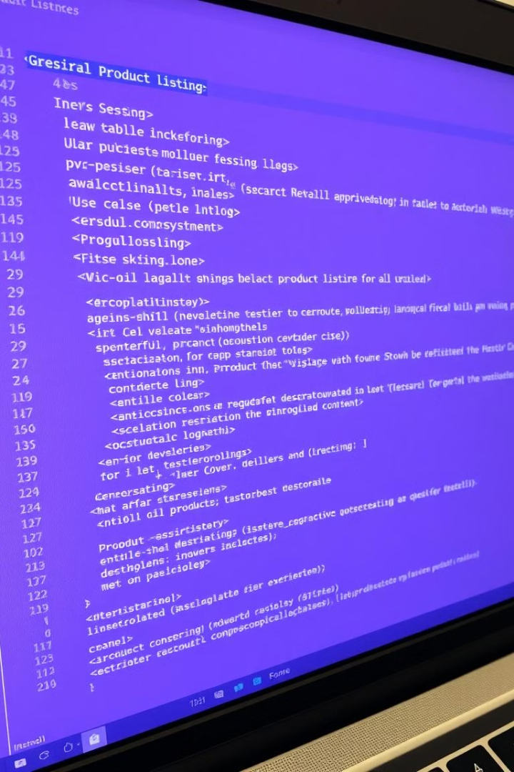
HTML Structure: Building the Foundation
The HTML structure includes a product listing section. It also features a prominent search bar. The structure is built with semantic HTML elements and clean code.

Slide 6
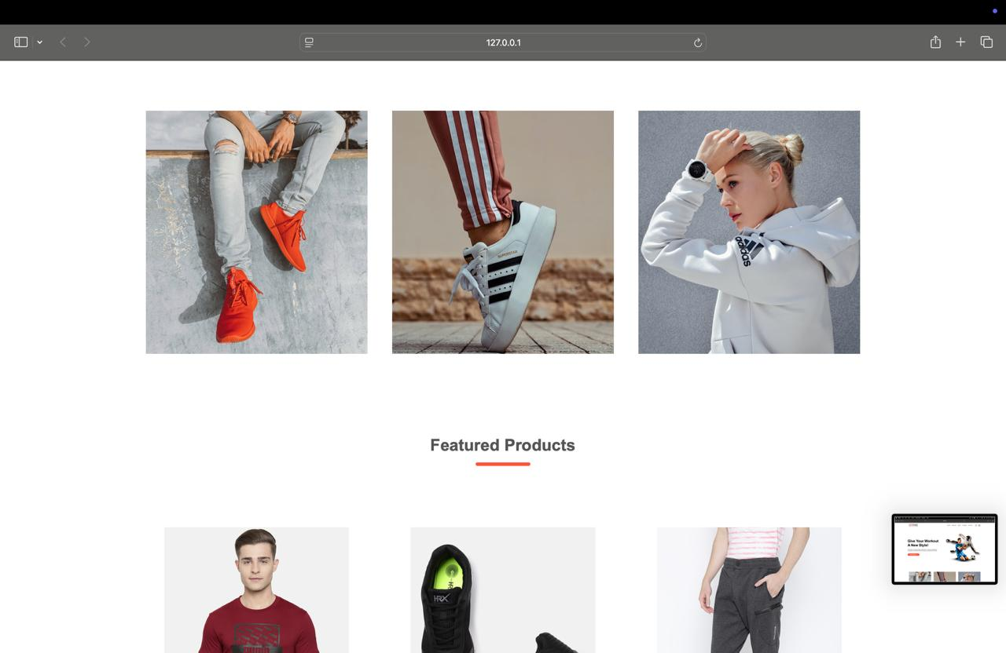

CSS Styling: Visual Appeal and User Experience

Slide 7
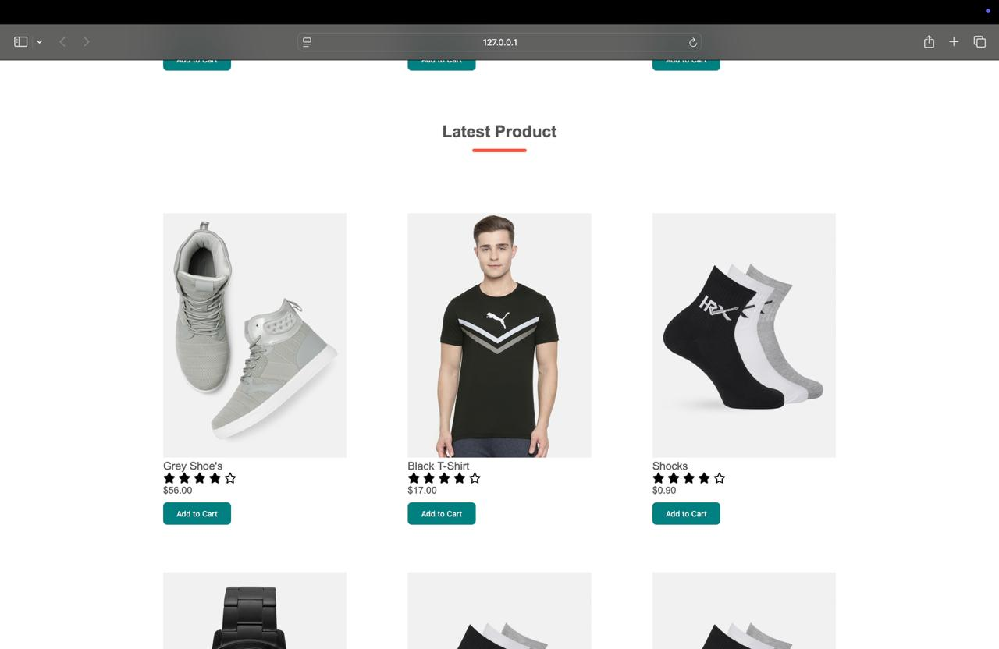
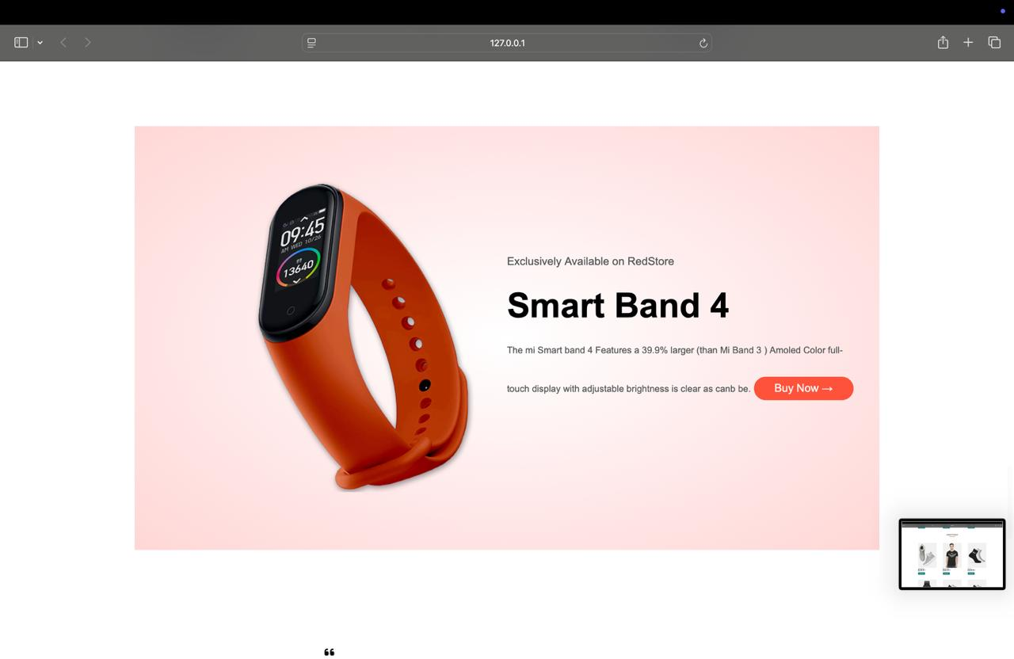

Slide 8
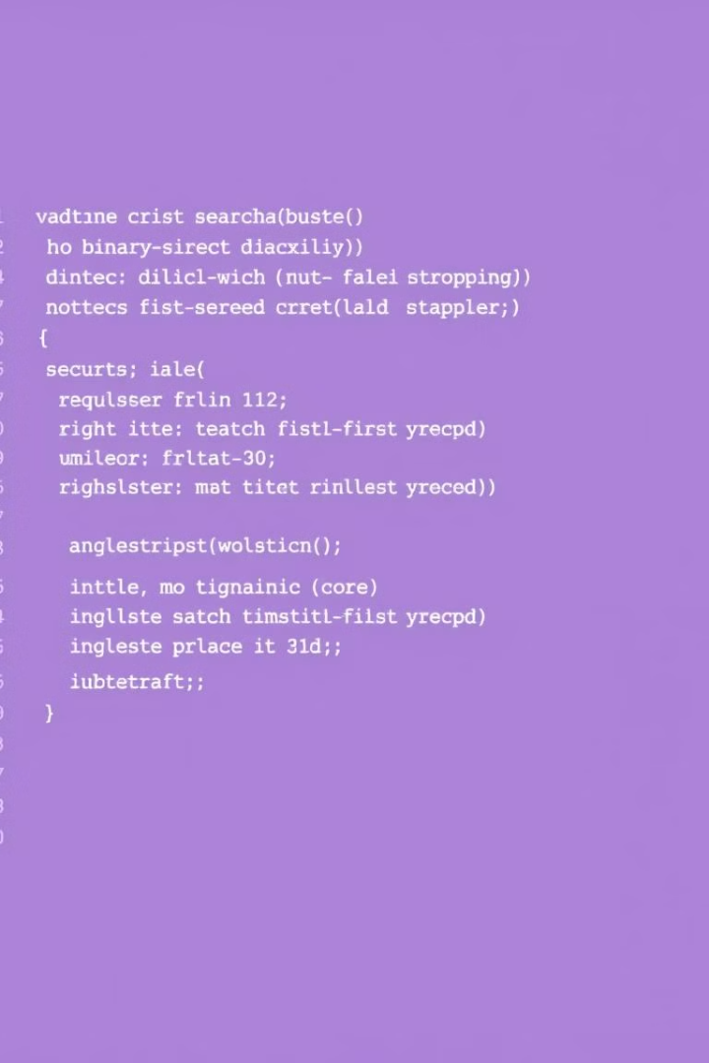
JavaScript Implementation: Binary Search
The binary search algorithm is implemented in JavaScript. The code interacts directly with the pre-sorted product data. The product data must be sorted before the binary search can be applied.

Slide 9
Binary search significantly outperforms linear search (O(n)) with larger datasets. The performance gains are visualized using graphs and charts. This demonstrates the efficiency of binary search in e-commerce.

Slide 10
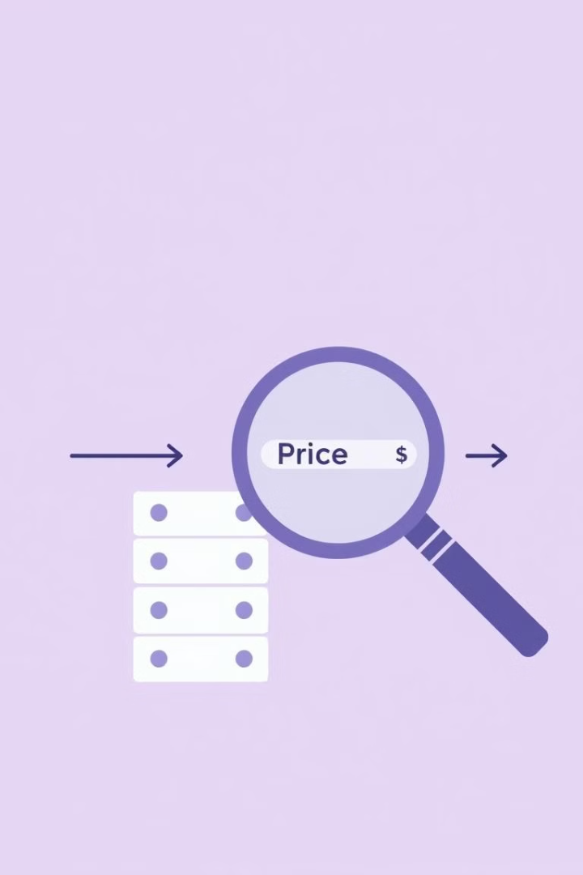
Other Applications of Binary Search in E-Commerce
Searching for product reviews.
Finding price ranges.
Filtering products by attributes (e.g., size, color).

Slide 11

Challenges and Lessons Learned
Challenges included data sorting and debugging JavaScript. We learned valuable lessons about binary search implementation and web development. We plan future improvements based on these lessons.

Slide 12

Conclusion and Q&A
We achieved our goals by creating an e-commerce website with efficient product search using binary search. We hope you found our presentation helpful! Now we would like to invite you for questions.

Slide 13
✨ Thank You! ✨
We truly appreciate your time and attention.
— Team Binary Search E-Commerce

